Slide 1
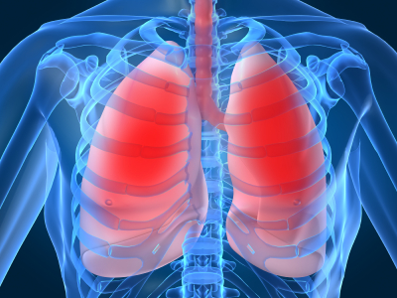
LECTURE NO (5)
Respiratory Physiology Bader Hassan
Lecturer Of Physiology
Gas transport
Faculty Of Medicine Dept.Of Physiology

Slide 2
Transport of oxygen
O2 is transported in the blood in 2 forms:
Dissolved in plasma----------------------- 2%
Bound to hemoglobin -------------------- 98%
O2 binds to hemoglobin in a rapid reversible oxygenation reaction
Iron remain in the ferrous state.

Slide 3
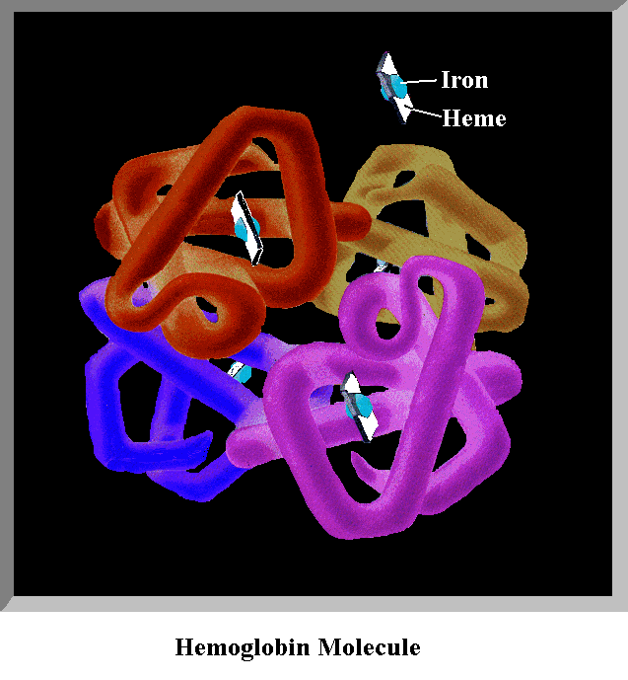

Slide 4
Oxygen-hemoglobin dissociation curve
Indicate the direct relation between PO2 & the percent saturation of Hb with O2.
PO2 of 40 mmHg gives O2 saturation of 75% as in veins.
PO2 of 95 mmHg gives O2 saturation of 97% as in arteries.
The affinity of Hb to oxygen is affected by certain factors which shift the curve to the right or to the left.

Slide 5
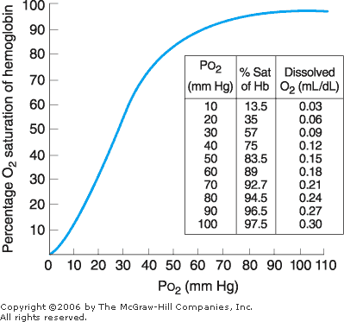

Slide 6
Shift to the right
Indicates decreased affinity of Hb to oxygen & increased release of oxygen to tissues.
Caused by :
High carbon dioxide.
High hydrogen ions.
High temperature.

Slide 8
Shift to the left
Indicates increased affinity of Hb to oxygen & decreased release of oxygen to tissues.
Caused by:
Low carbon dioxide.
Low hydrogen ions.
Low temperature.

Slide 10
Transport of CO2
CO2 is transported in 3 forms:
As bicarbonate (the main form).
Bound to proteins.
Dissolved .

Slide 11
Most carbon dioxide in the plasma enters RBCs where it reacts with water to form bicarbonate.
Then bicarbonate enters the plasma in exchange to chloride which enters RBCs.

Slide 12
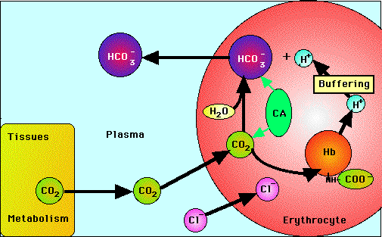
Carbon Dioxide Transport
Tissue level

Slide 13
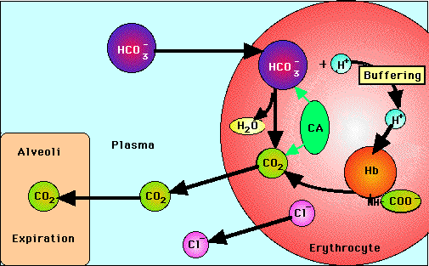
Carbon Dioxide Transport
Lung level

Slide 14
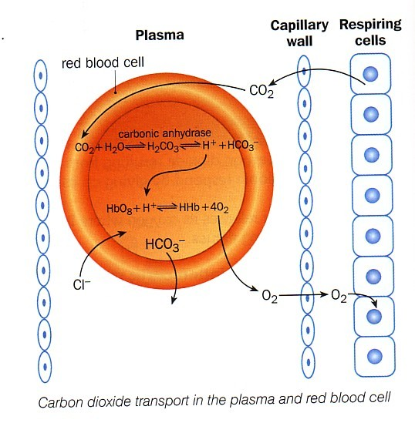

Slide 15
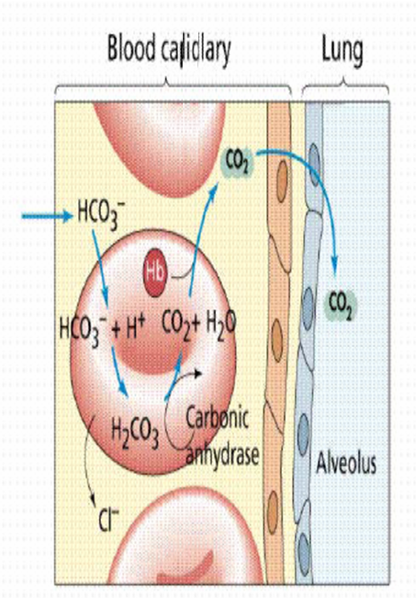
Capillary to lung exchange

Slide 16
(لا إله إلا أنت سبحانك إني كنت من الظالمين)

